Slide 1
Types of angles
Miss L
Year 7

Slide 2
Learning Intentions
Students will be able to
Label the 6 types of angles
Learn how to use a protractor

Slide 3

Think-pair-share
Think
  What do you think an angle is?
  How many types of angles can you name?
Pair
  Share your answers with the person next to you.
Share
  Put your hand up to share your answers with the class.
Notes:
Guide students through the question.
Option 2: Dot plots handout (Scaffolded for kids who may need extra help)

Slide 4
24
7
30
Topic: Type of Angles
Date:
EQ – What are the different types of angles and how do I measure them?
What does an Angle look like?
Arm
Angle
Vertex
Arm
The amount of space between two straight lines. Measured in degrees.
Example: 45°
What is an Angle?

Slide 5


Slide 6
Complete the following in your Graphic Organiser
Once complete, glue it in your notebook

Slide 7
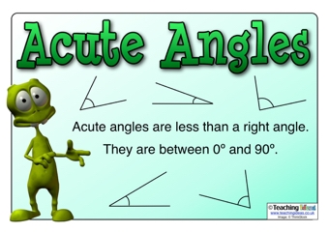
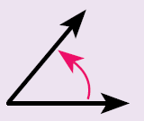
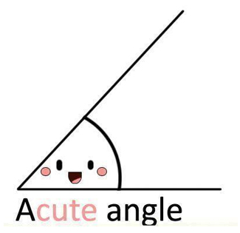
Acute angle
Name: Acute angle
Size: less than 90°
Diagram:
Notes:
Guide students through the question.
Option 2: Dot plots handout (Scaffolded for kids who may need extra help)

Slide 8
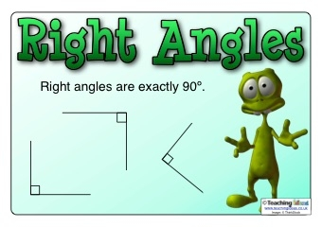
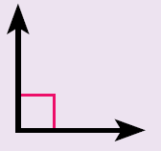
Right angle
Name: Right angle
Size: exactly 90°
Diagram:
That means it’s a right angle
A right angle is a quarter turn
Notes:
Guide students through the question.
Option 2: Dot plots handout (Scaffolded for kids who may need extra help)

Slide 10
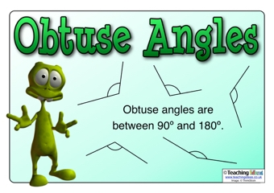
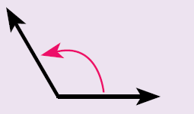
Obtuse angle
Name: Obtuse angle
Size: between 90° and 180 °
Diagram:
Notes:
Guide students through the question.
Option 2: Dot plots handout (Scaffolded for kids who may need extra help)

Slide 11
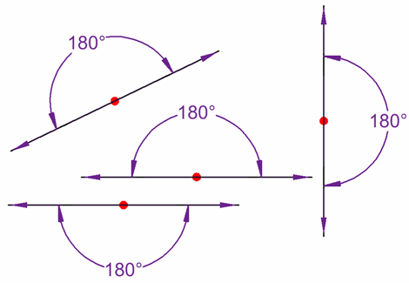
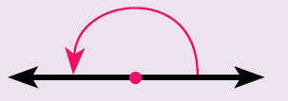
straight angle
Name: Straight angle
Size: exactly 180°
Diagram:
A straight angle is a half turn
Notes:
Guide students through the question.
Option 2: Dot plots handout (Scaffolded for kids who may need extra help)

Slide 12
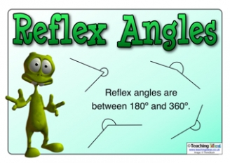
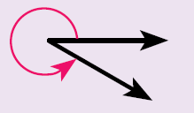
reflex angle
Name: Reflex angle
Size: between 180° and 360°
Diagram:
Notes:
Guide students through the question.
Option 2: Dot plots handout (Scaffolded for kids who may need extra help)

Slide 13
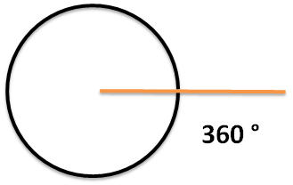
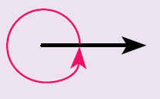
revolution angle
Name: Revolution angle
Size: exactly 360°
Diagram:
A revolution angle is one complete turn
Notes:
Guide students through the question.
Option 2: Dot plots handout (Scaffolded for kids who may need extra help)

Slide 15
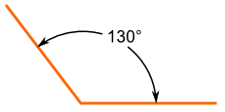
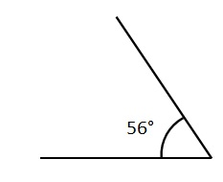
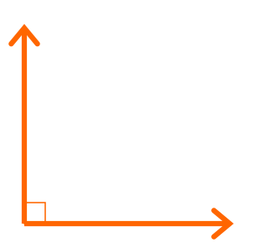

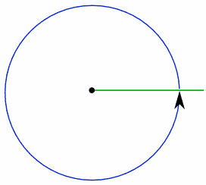
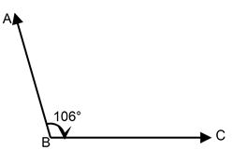
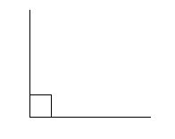
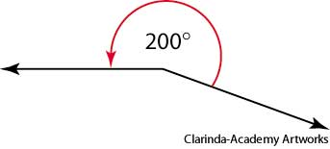
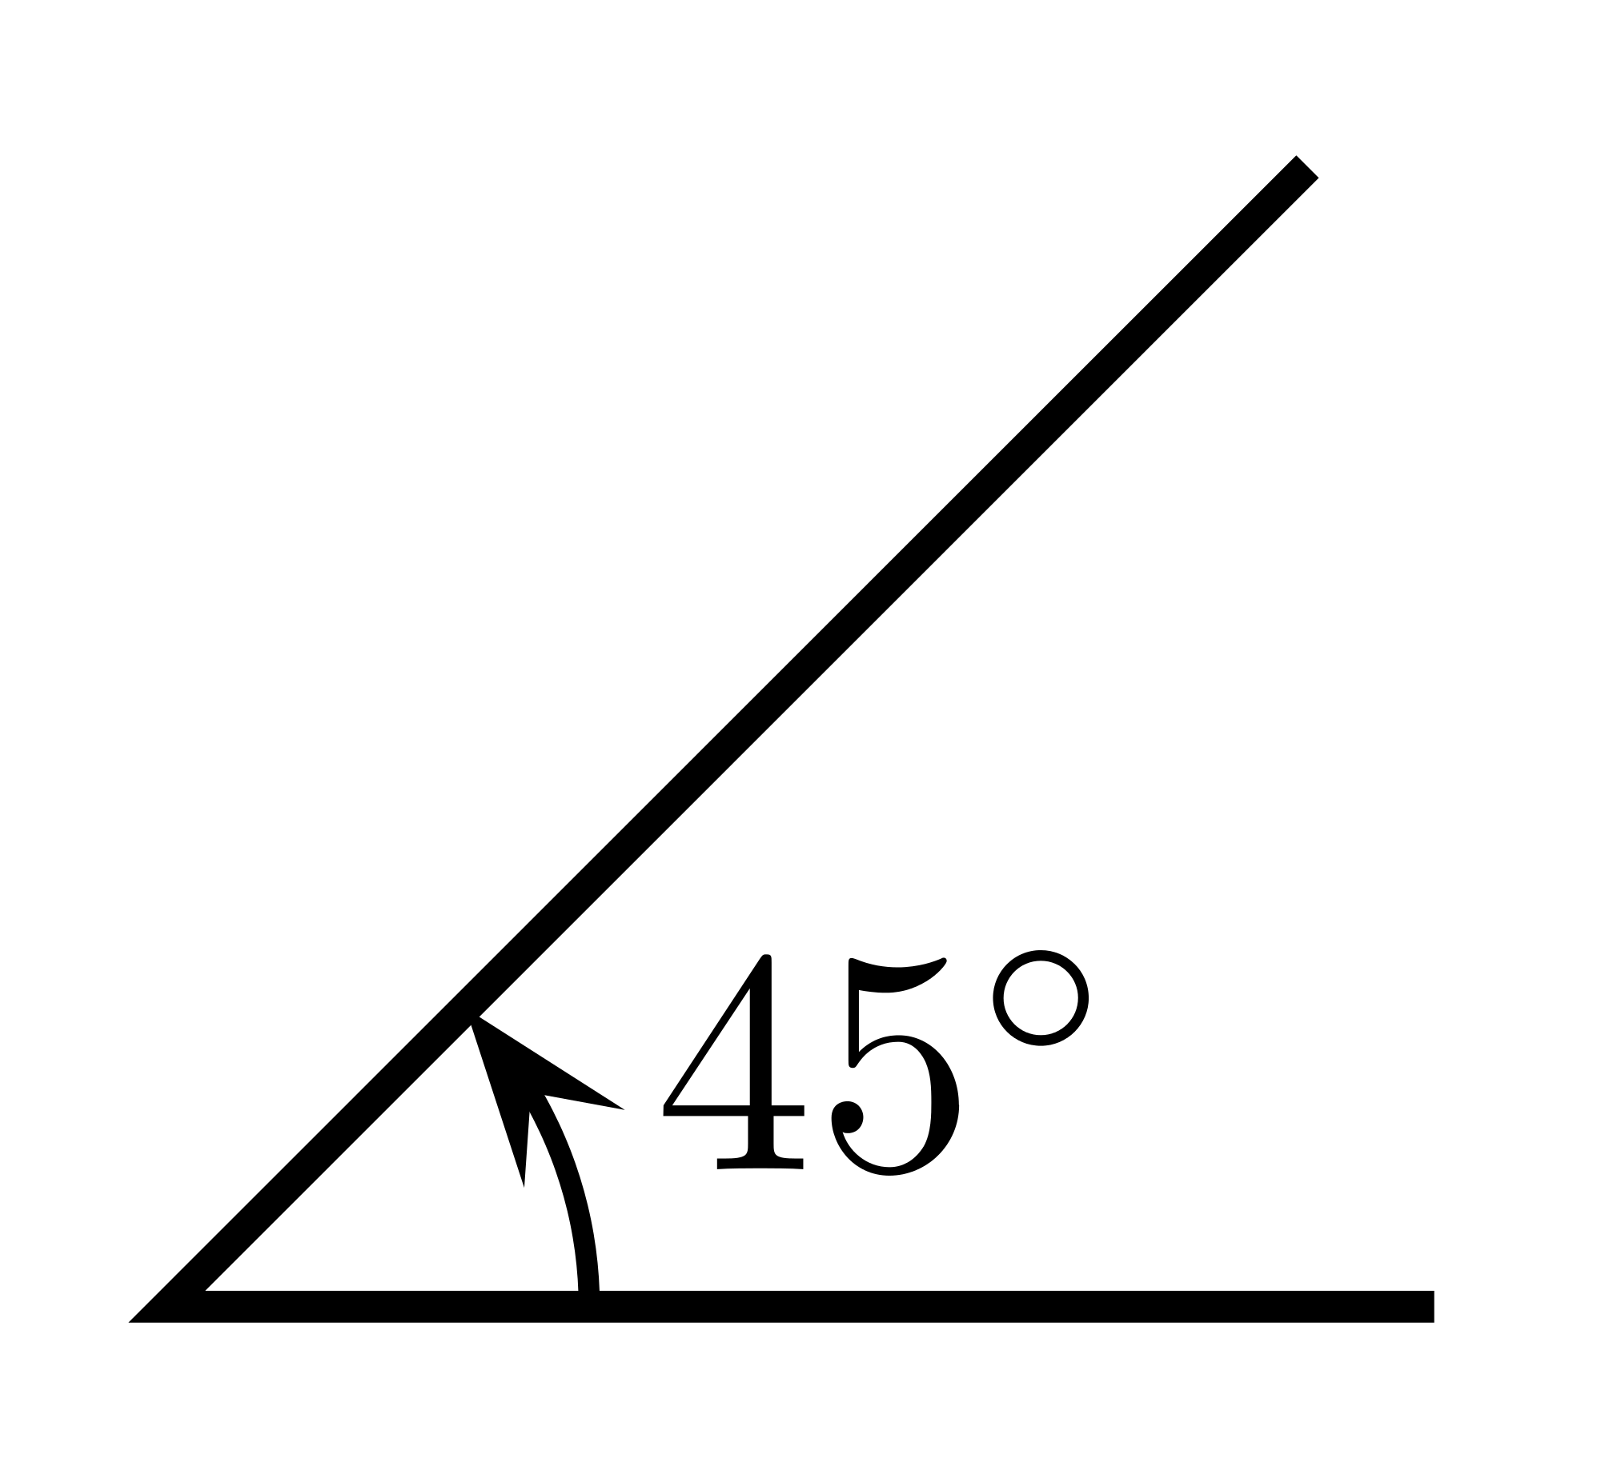
Practice
Which angle is which?!
Notes:
Guide students through the question.
Option 2: Dot plots handout (Scaffolded for kids who may need extra help)

Slide 16
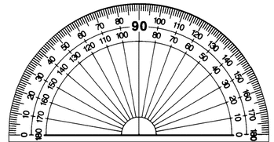
24
7
30
Topic: Type of Angles
Date:
EQ – What are the different types of angles and how do I measure them?
How to measure angles?
We use a nifty device called a protractor!

Slide 17
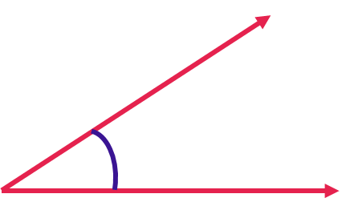
24
7
30
Topic: Type of Angles
Date:
EQ – What are the different types of angles and how do I measure them?
How to measure angles?
Step 1: Line up the bottom of the angle with the straight line of the protractor.

Slide 18
24
7
30
Topic: Type of Angles
Date:
EQ – What are the different types of angles and how do I measure them?
How to measure angles?
Step 2: Measure from the bottom arm to the top arm of the angle
Make sure the vertex is lined up with the middle of the protractor

Slide 19
24
7
30
Topic: Type of Angles
Date:
EQ – What are the different types of angles and how do I measure them?
How to measure angles?
Step 3: Read the protractor = 31°

Slide 20
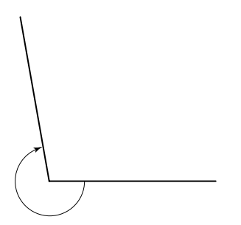
24
7
30
Topic: Type of Angles
Date:
EQ – What are the different types of angles and how do I measure them?
How to measure reflex angles?
Step 1: Measure the inside angle
Inside angle = 100°
Step 2: Reflex angle = 360 – 100
= 260°
Inside acute angle

Slide 21
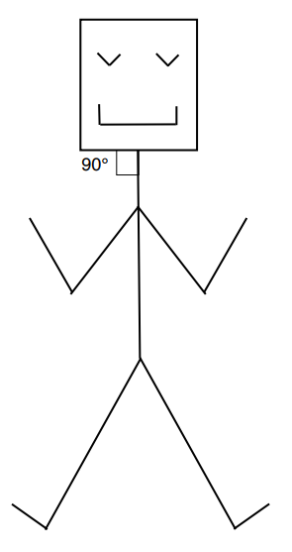
Practice
Stickman Angles Worksheet
Find and label as many angles as you can on the stickmen
Complete your summery!
Notes:
Guide students through the question.
Option 2: Dot plots handout (Scaffolded for kids who may need extra help)

